Slide 1
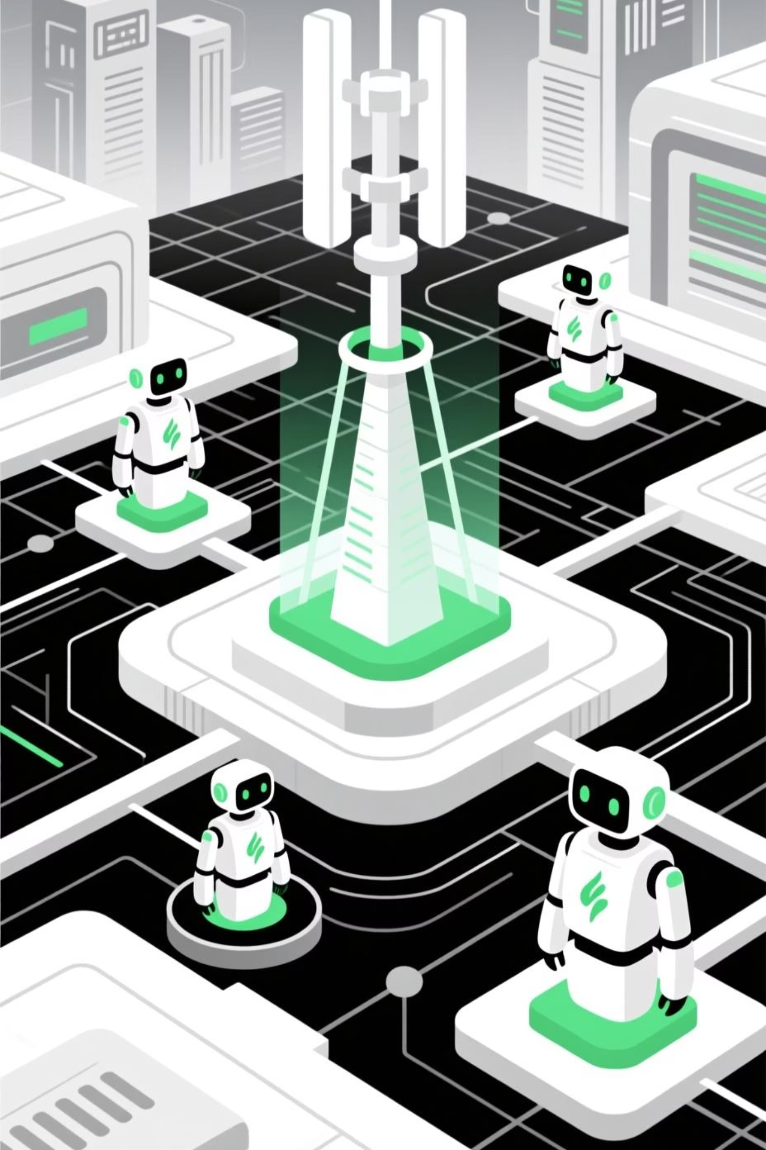
GreenLink Agent
Energy-Aware Network Intelligence
TEAM SOLAS

Slide 2



Meet The Team
Balaji Segu Krishnaiah
Akarsh N Lakshmisha
Sai Shreyas Gubbi Harish
MSc in AI (DCU)
MSc in AI (DCU)
MSc in Cloud Computing (NCI)
Previously at McKinsey & Tejas Networks
Previously at Yellow.Ai
Previously at Ernst & Young (EY)
skbalajimbl1@gmail.com
akarshnl17@gmail.com
ghsaishreyas3@gmail.com

Slide 3
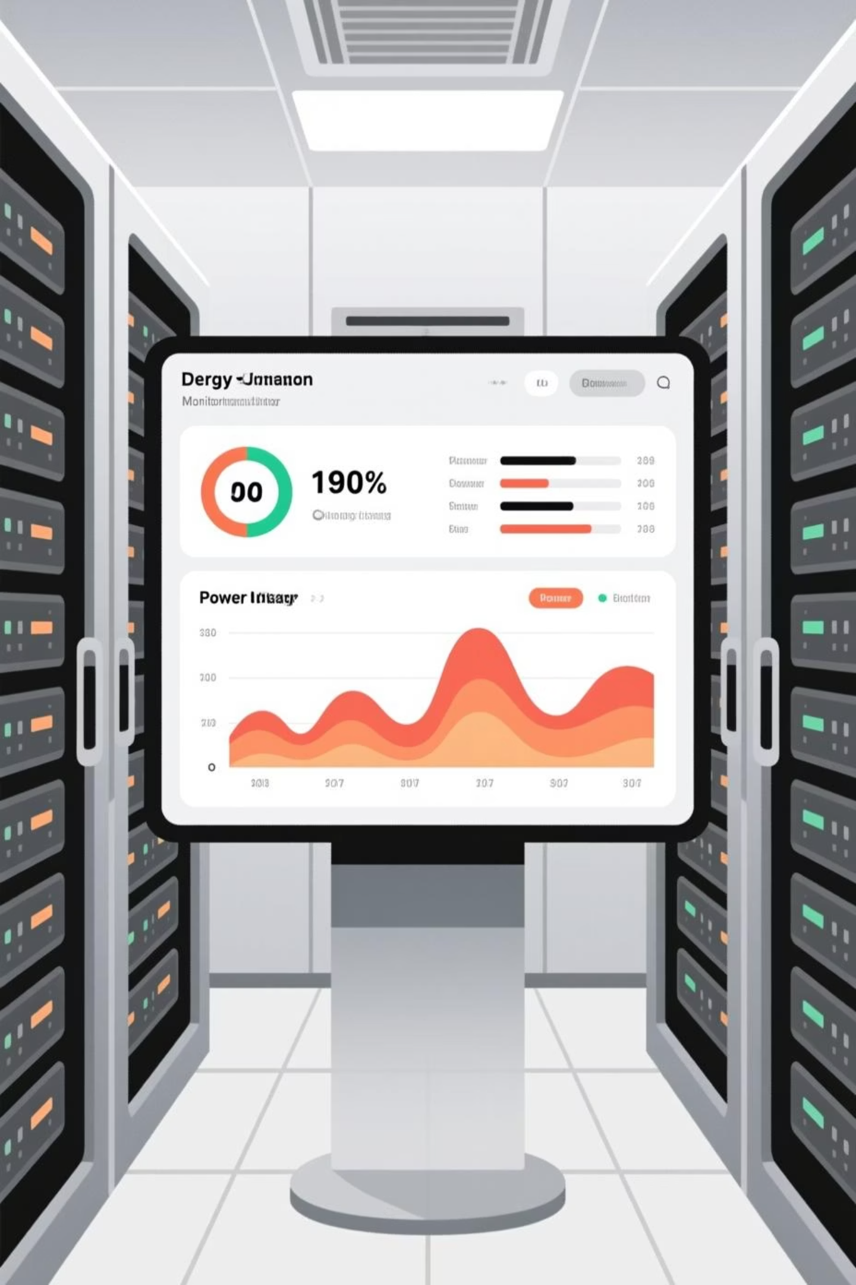
The Challenge: Networks Consume Too Much Power
Modern telecom networks operate at full capacity regardless of actual demand. Idle nodes waste energy whilst congested links strain infrastructure. The result: bloated OPEX and sustainability concerns that conflict with 6G/5G ambitions.

Slide 4

THE SOLUTION
Autonomous Decision Making
Real-Time Adaptation
Nodes sleep when idle, traffic reroutes to active paths. No manual intervention required.
Rule-based agents observes network state and makes intelligent choices instantly.
Measurable Impact
Dashboard displays energy saved, node states and traffic distribution in real time.

Slide 5

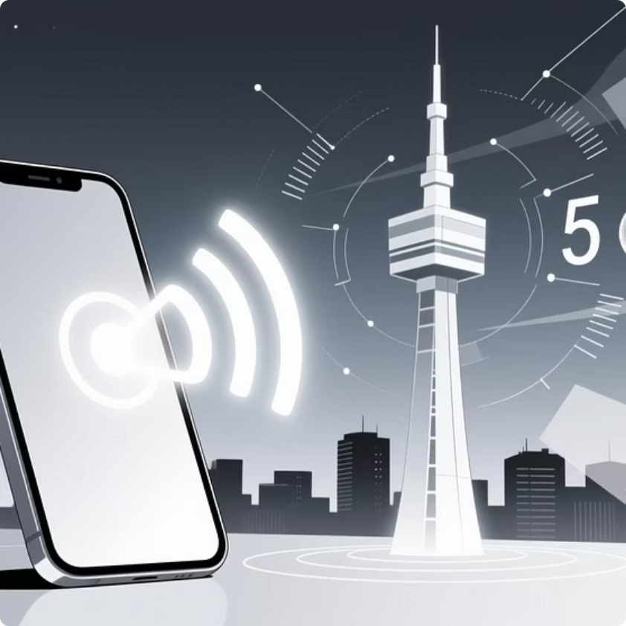
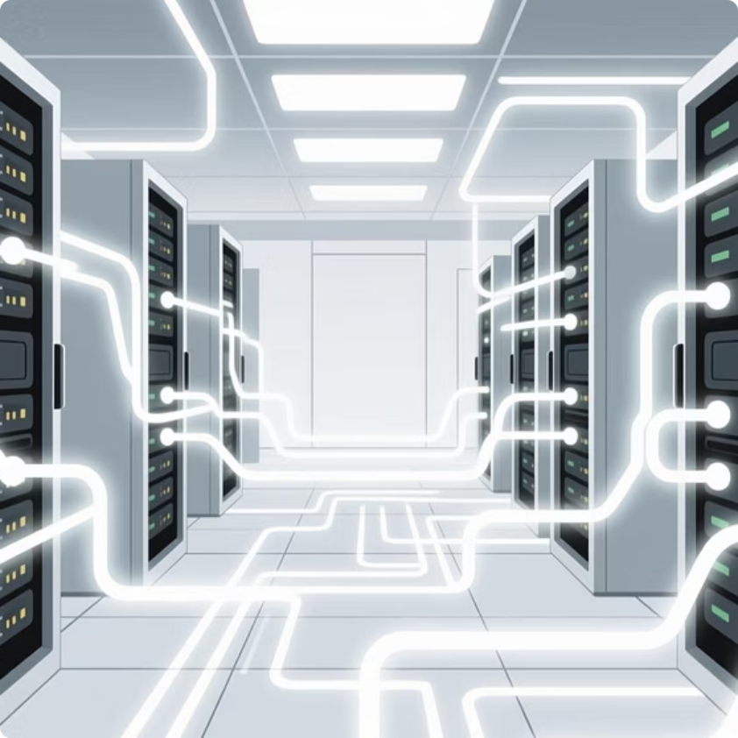

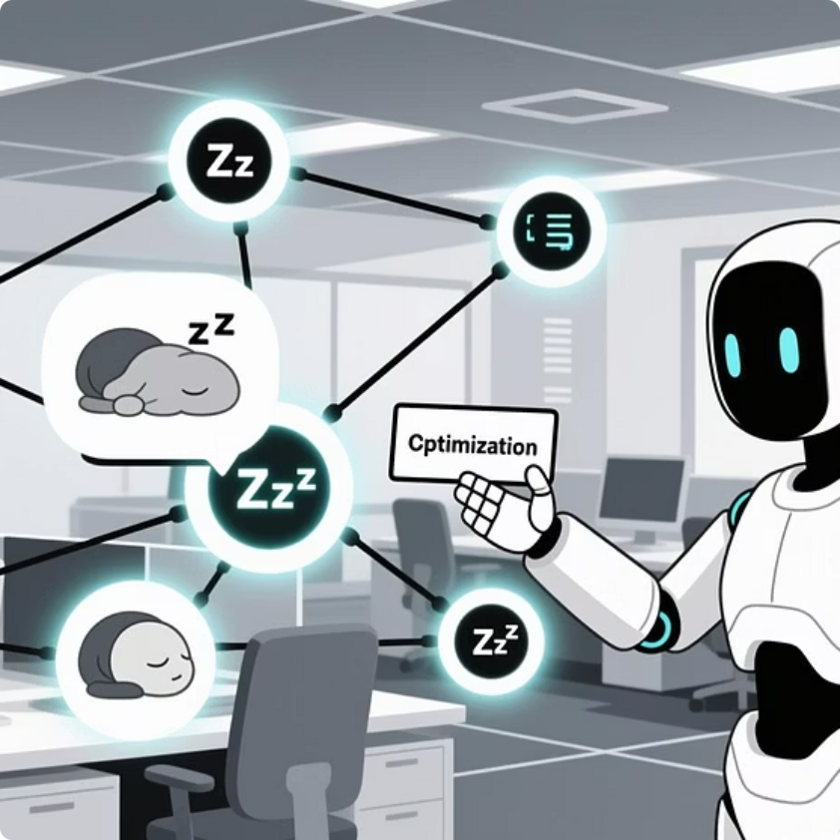
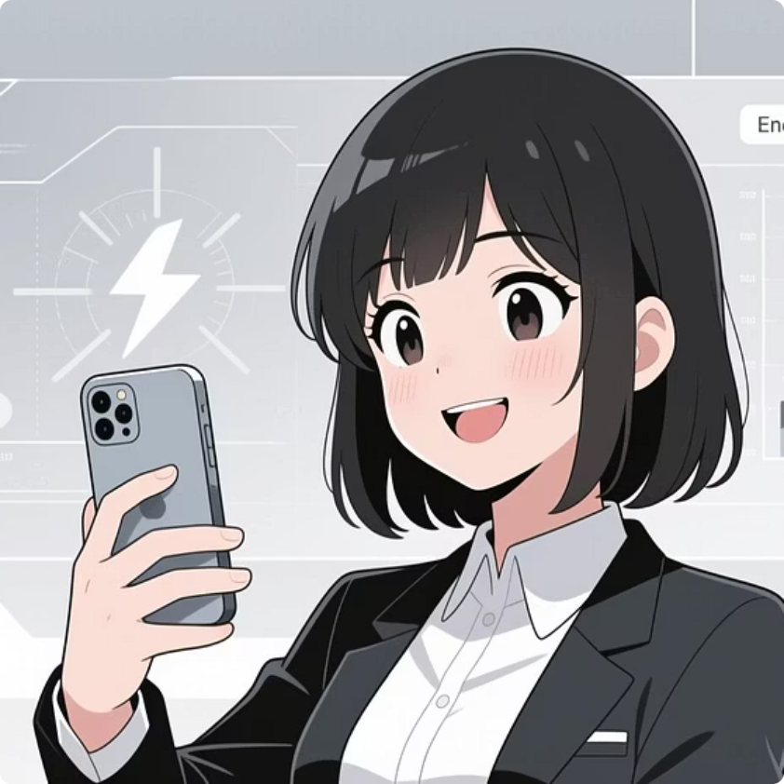
Sarah's Seamless Connection: GreenLink's AI in Action
Experience the silent power of GreenLink's AI as it works behind the scenes to deliver exceptional service and save energy, all while Sarah makes a simple video call.
Sarah begins her video call, connecting with friends effortlessly.
Her signal reaches a 5G tower, with real-time traffic and energy usage being monitored.
Data efficiently routes through edge nodes and the core network infrastructure, visualized as glowing pathways.
GreenLink's AI, powered by AWS Bedrock, analyzes real-time traffic patterns and energy usage.
The AI instantly optimizes the network, putting idle nodes to sleep and rerouting traffic for efficiency.
Sarah enjoys uninterrupted service, while the network operates with significantly lower energy consumption.

Slide 6
How GreenLink Works
1
2
Observe
Reason
Agent collects traffic and energy metrics from all network nodes every few seconds.
LLM or rules engine analyses data: idle nodes flagged, congestion detected, optimal routes identified.
3
4
Act
Explain
Agent powers down idle nodes, reroutes traffic, logs all decisions with reasoning.
Natural language output shows why each decision was made—transparency builds trust.

Slide 7





GreenLink System Workflow: Technical Architecture
Network Nodes
AWS Bedrock AI
Data collection from sensors & devices
AI processing & analysis
GreenLink Architecture
Real-time, bidirectional ecosystem with DynamoDB & API Gateway
Optimization Engine
Lambda Functions
API Gateway Decisioning & policy generation
Action execution & triggers

Slide 8

User Flow: From Data to Decision
Step 1: Simulate 10–20 network nodes with randomised traffic and power consumption.
Step 2: Agent observes and decides every few seconds from AWS Lambda, pushes this to Agent.
Step 3: Agent makes decision then Idle nodes sleep, congested links reroute.
Step 4: Dashboard logs all actions. Audience sees energy saved accumulate in real time.

Slide 9
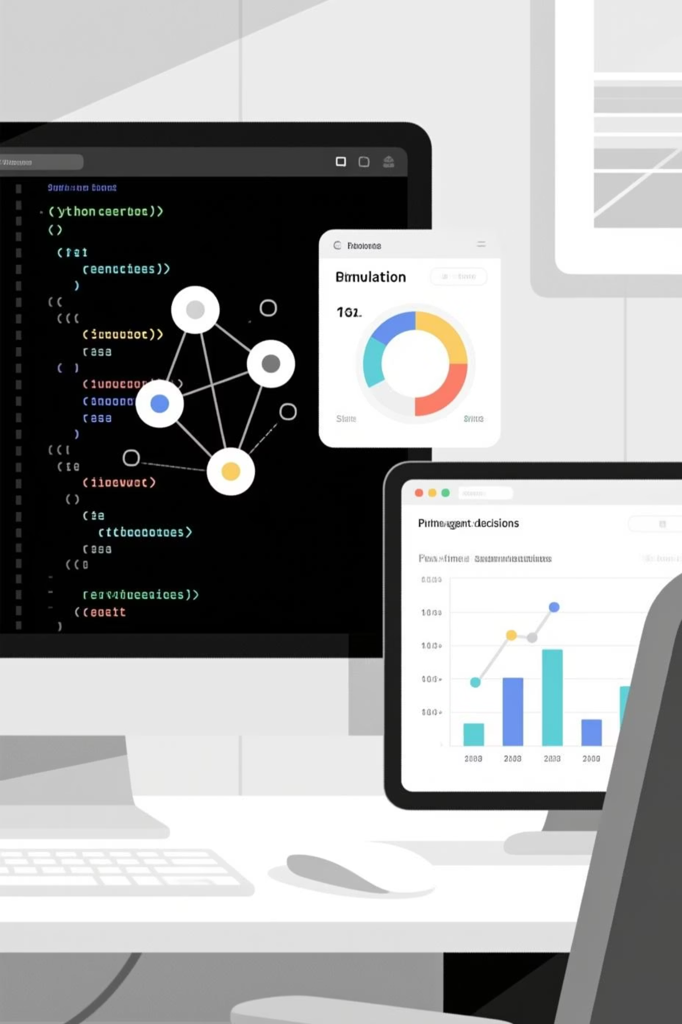
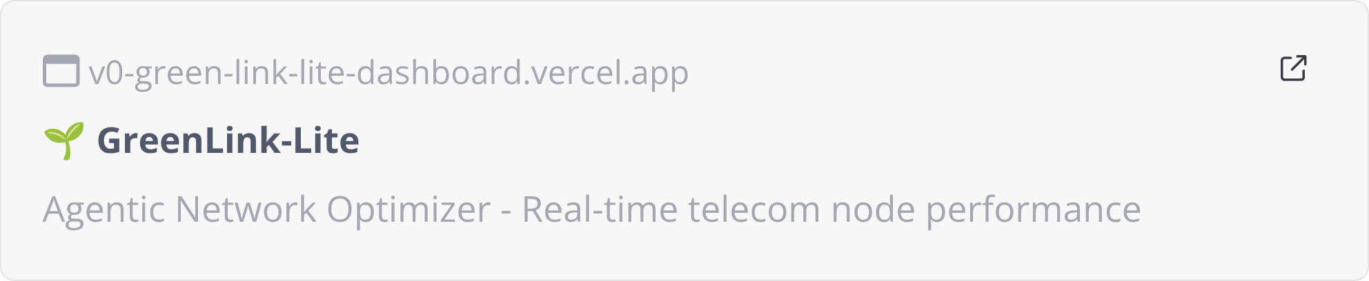
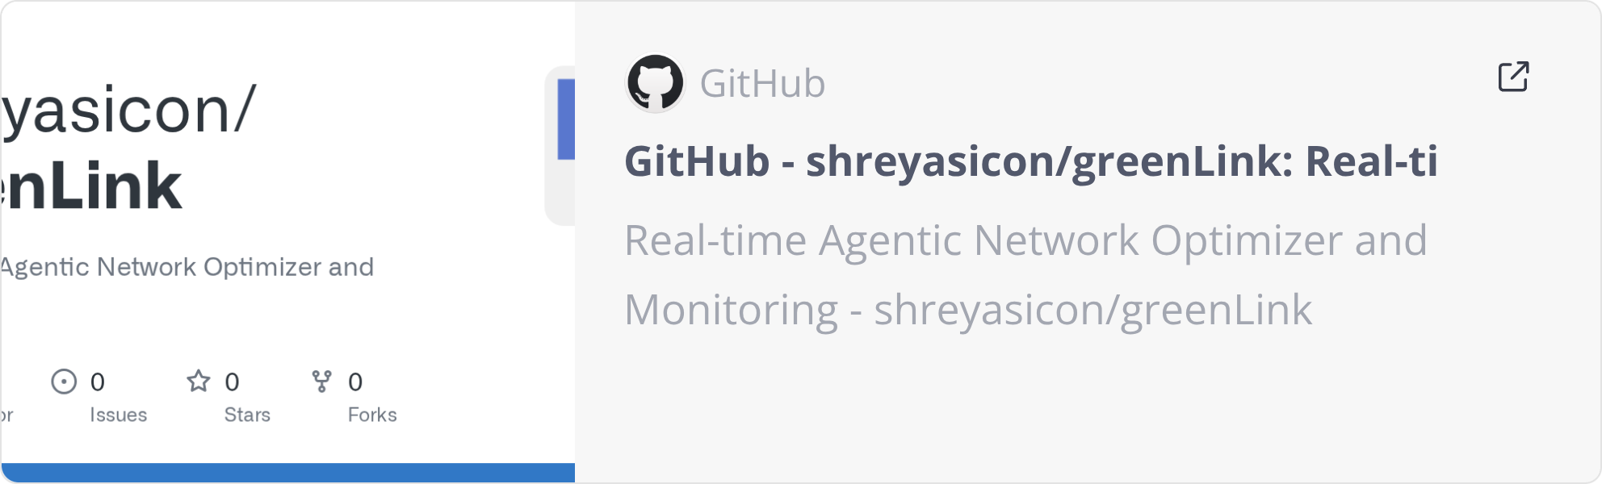
Implementation: Ready to Scale
GreenLink is engineered for rapid deployment. Simulated metrics eliminate infrastructure dependencies. AI agent core with optional Streamlit dashboard handles visualisation. Small LLM or lightweight rules engine powers decision logic.

Slide 10

AWS Architecture Flow

Slide 11
Key Metrics: The Numbers That Matter
40%
<100ms
99.9%
$2.5B+
Energy Reduction upto
Decision Latency upto
Service Resilience upto
Global Market Potential
Average power savings from intelligent node sleep and traffic rerouting.
Agent responds to network changes in milliseconds. Transparent reasoning included.
Traffic rerouting ensures no service degradation while nodes optimise power consumption.
Annual revenue opportunity from worldwide telecom energy optimization across 5G/6G networks.

Slide 12
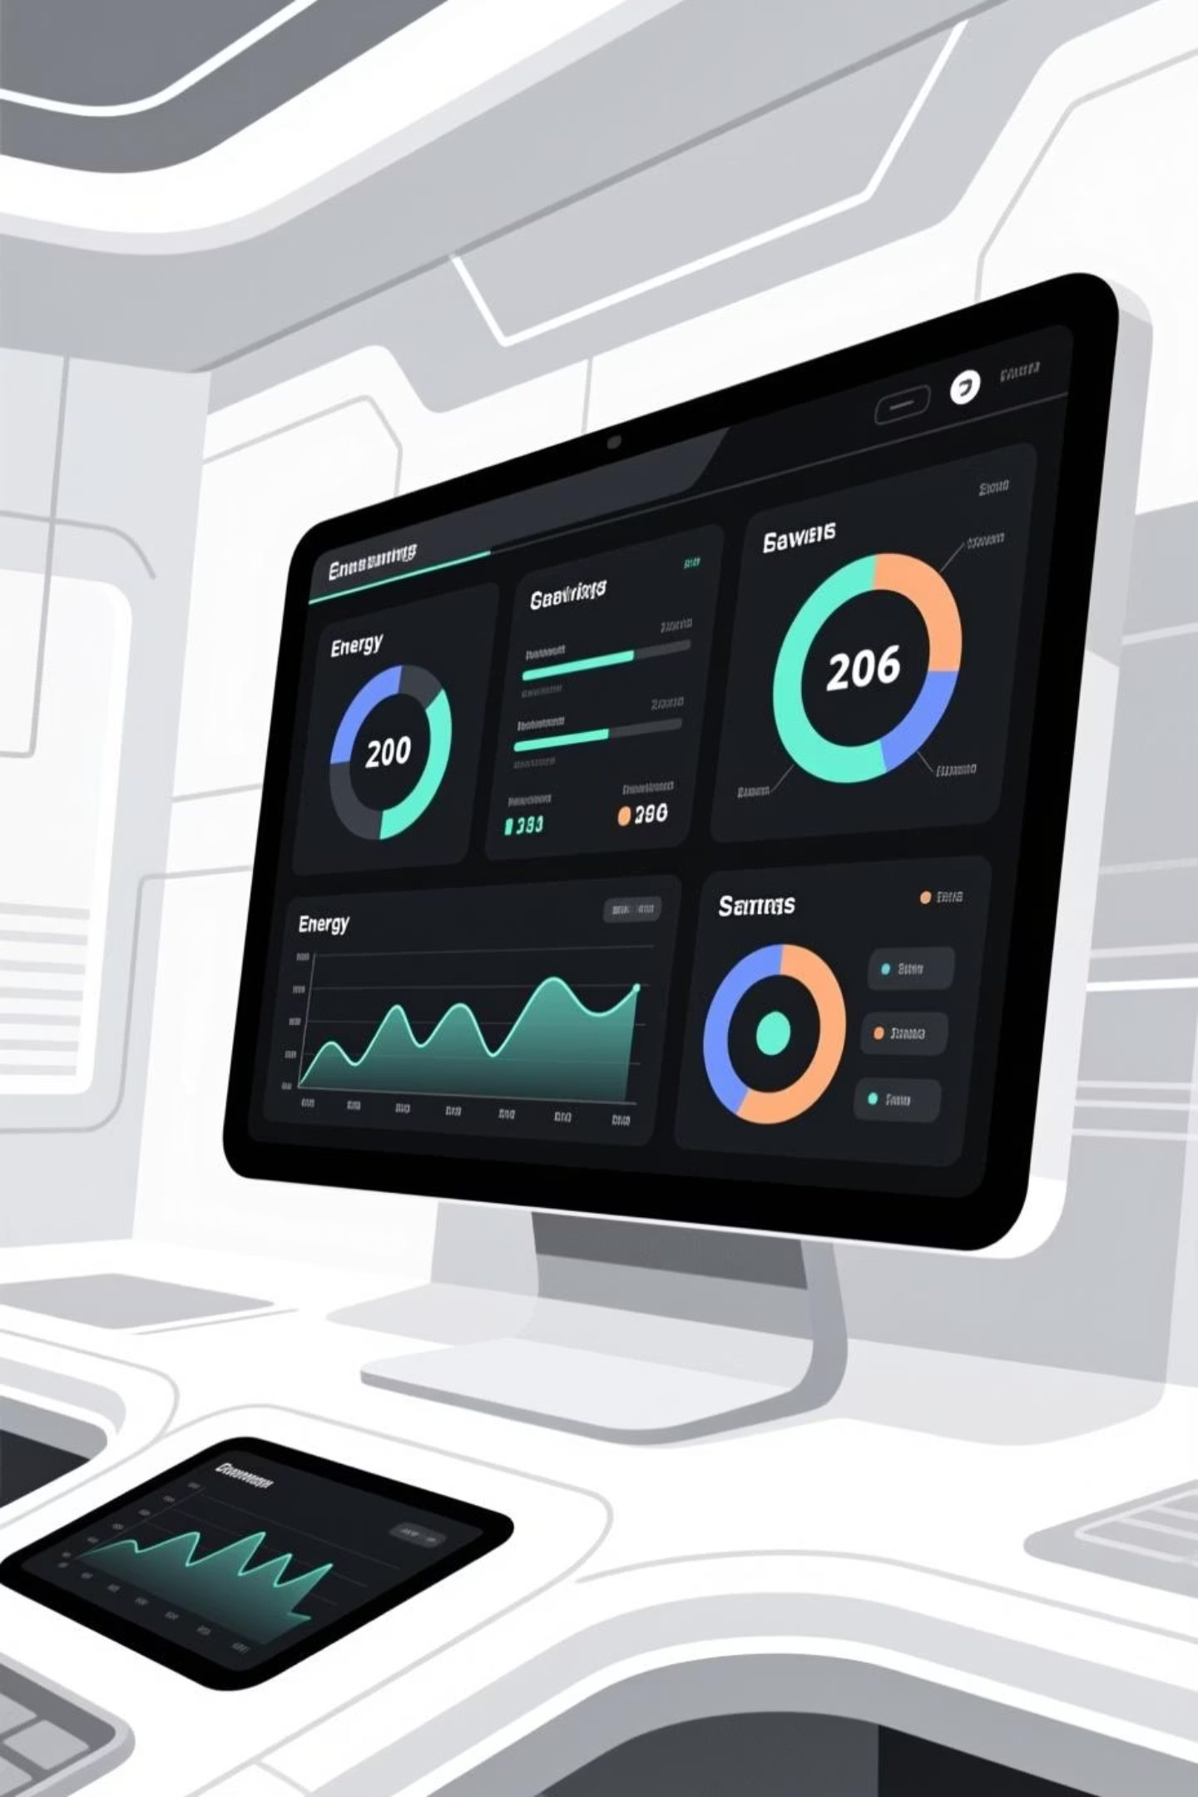
Proposed Solution Impact & Potential Benefits
Dynamic routing and optimization
Edge and Cloud integration
Visualization
Metric based observation

Slide 13
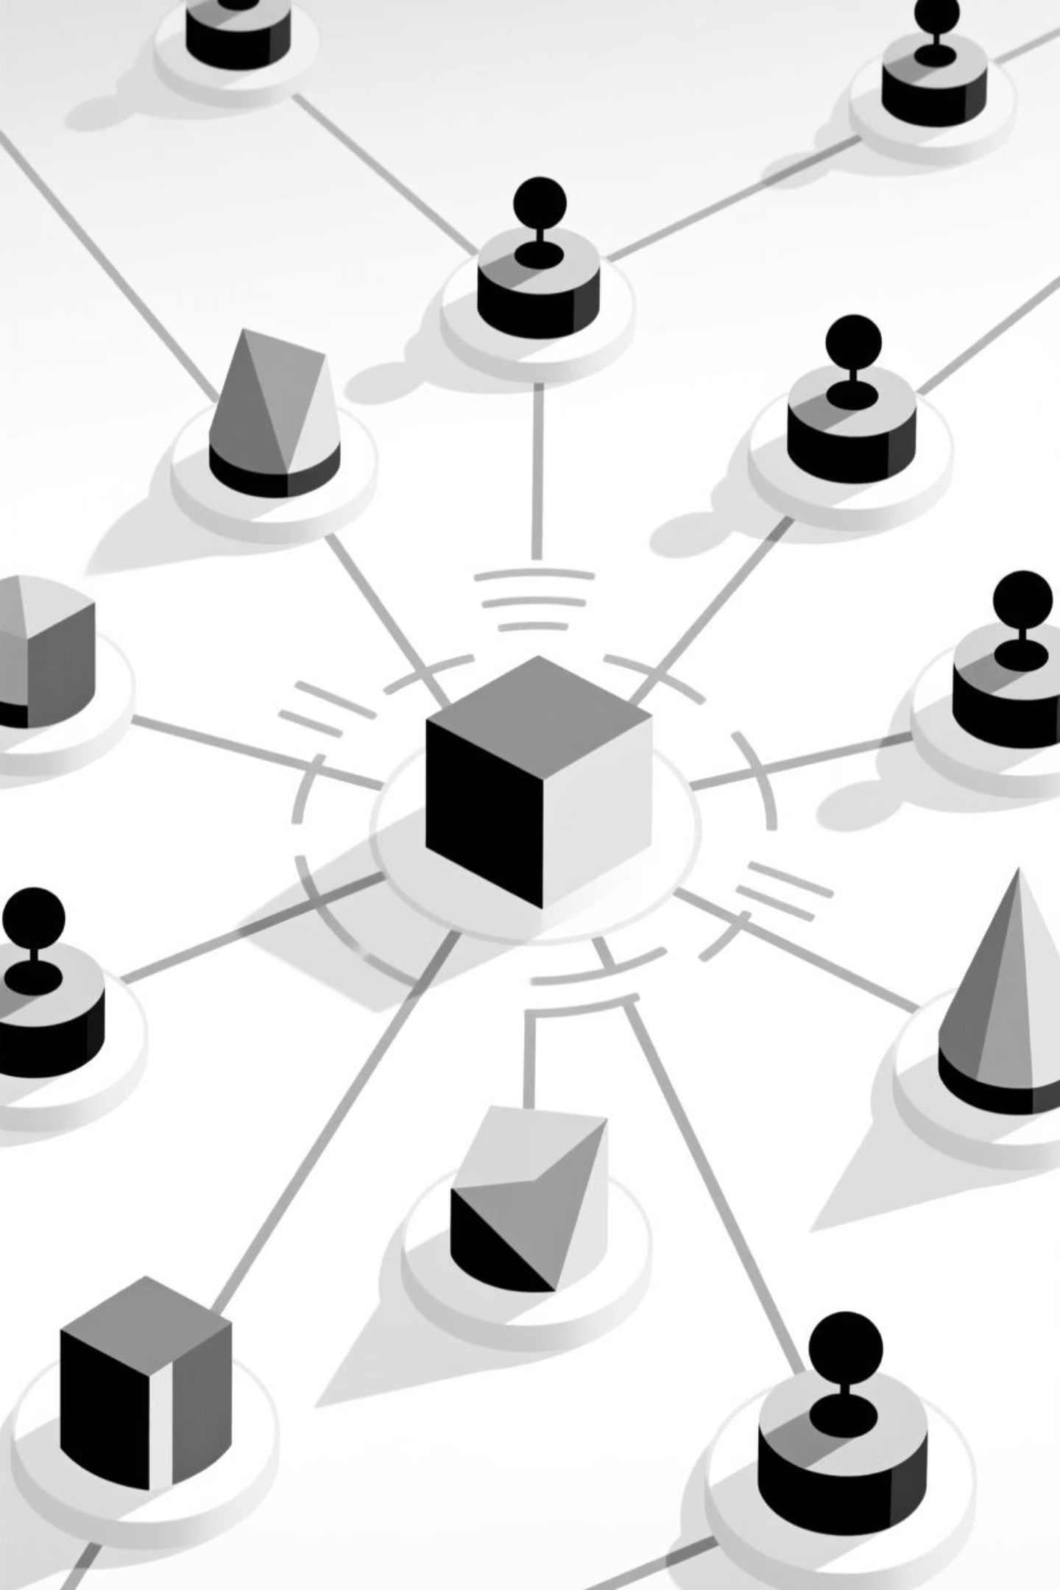



Scalability & Future Roadmap
Today: Single Agent
One agent manages one network zone.
Next: Multi-Agent
Multiple agents coordinate via A2A communication.
Future: Predictive
Agent predicts load, pre-scales resources proactively.

Slide 14




The GreenLink Advantage: A Unique Proposition
GreenLink stands apart by combining critical capabilities into a compact, interpretable, and hackathon-ready solution.
Real-time Telemetry
Autonomous Agents
Monitors per-node energy and traffic metrics instantly across the network, providing unparalleled visibility.
Leverages small LLM or rule-based agents to make intelligent, self-healing network decisions.
Explainable AI
Prototype & Demo Ready
Provides natural language explanations for every decision, fostering transparency and trust in the system.
Deployable in a simulated network for rapid hackathon development or quick proof-of-concept demonstrations.

Slide 15

Possible Revenue Streams
SaaS Subscriptions: Charge per organization or number of nodes monitored
Premium Features: Advanced analytics, custom dashboards, predictive AI
Integrations: Partner with IoT and energy management providers
Incentives & Gamification: Users earn rewards for energy savings
Consulting & Reports: Custom insights and operational recommendations

Slide 16


